Slide 1
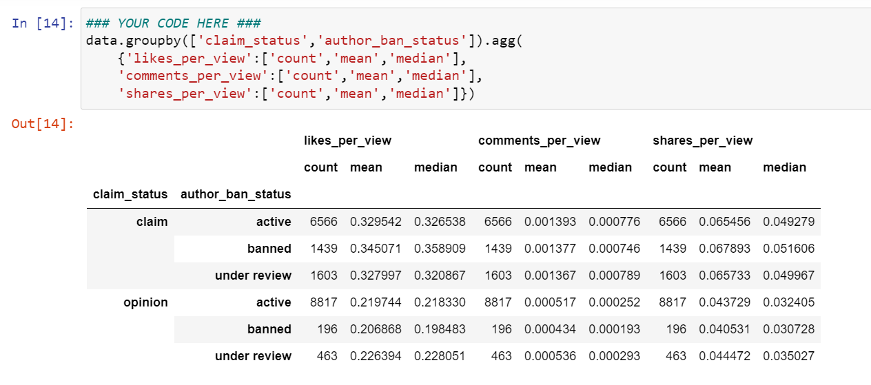
TikTok Project Preliminary Data Summary
Executive Summary Report
Project Overview
TikTok leadership ask data team to develop a predictive model that can determine whether a video contains a claim or offers an opinion to reduce the backlog of user reports and prioritize them more efficiently. The data team performed a preliminary data inspection.
There are some null values in 7 columns
There is quite balanced for claim (50.3%) and opinion (49.7%)
Higher video view, like, and comment count on banned and under review than active author
Check validity for some unusual data
Conduct Exploratory Data Analysis (EDA)
Conduct descriptive analysis to understand the data further
Create and run a regression model

